Slide 1


Corona – TR7ZK2

Slide 2


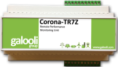


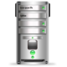

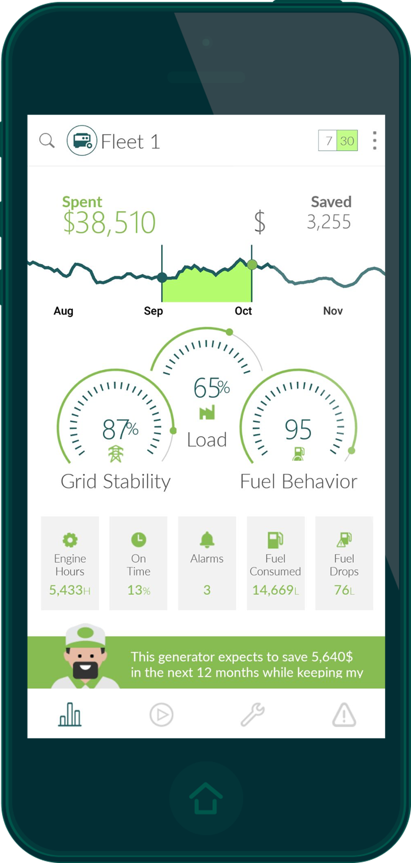


Solution Architecture
Corona TR7Z Controller
Corona TR7Z Controller
Corona TR7Z Controller
SMS
E-mail
ZON Control
Server
Mobile
Internet
Network Operations Center (NOC)
External Users
Users

Slide 3
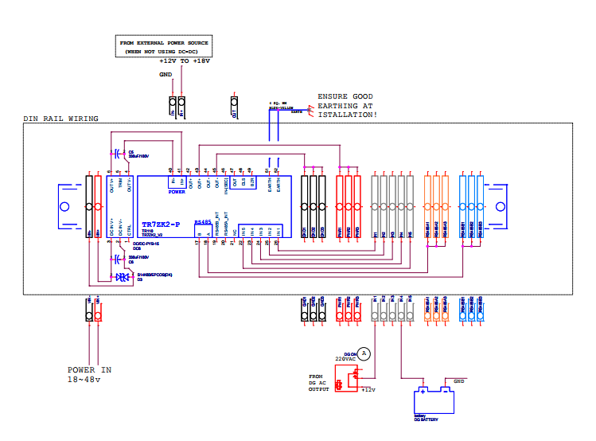

Slide 4
Connecting Corona to PC
Insert a SIM card (GPRS) into the Corona TR7ZK2
Insert the RS485 converter to a USB connector
Plug in the USB cable to your PC
Connect the Corona TR7ZK2 device to a power source (12V)

Slide 5
Corona TR7ZK2 is built with surge protection
Unit must be grounded so the surge voltage will be diverted to the ground without damaging the unit
Grounding must be healthy and properly connected to the ground
Grounding must be stable and proper
Unit must be grounded to the general site grounding
All equipment must be grounded to the general site grounding
Ungrounded units will be void of warranty
Why Ground the Unit?

Slide 6
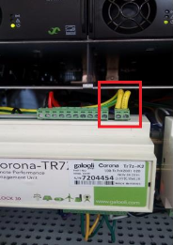
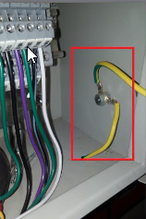
Grounding the unit
Corona contains 2 pins in the color terminal block to ground the unit
If Galooli DB is used, the whole box should be grounded to the DB box earthing point

Slide 7
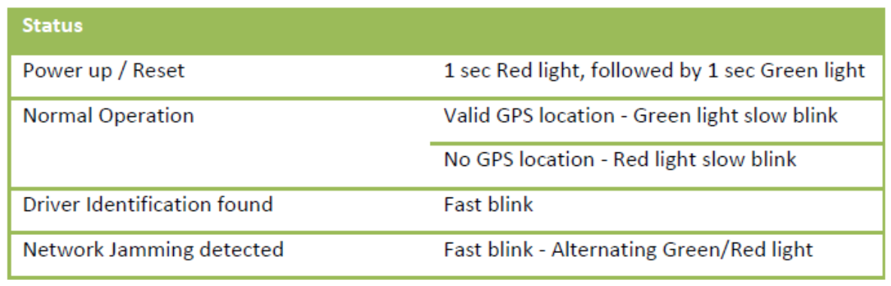
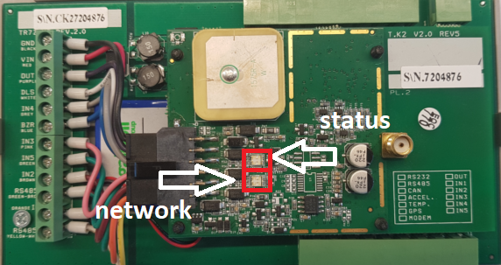
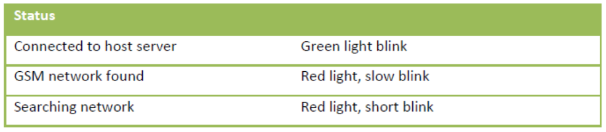
LED Status
Status Led Indication
Network Led Indication

Slide 8
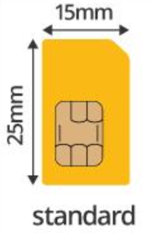
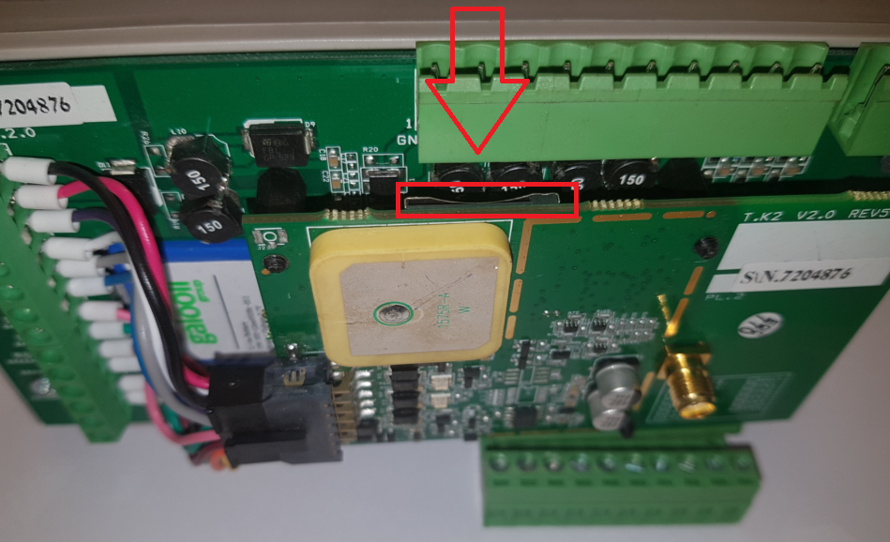
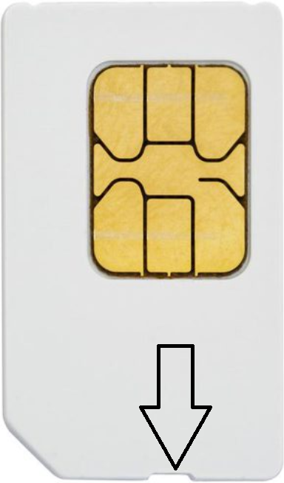
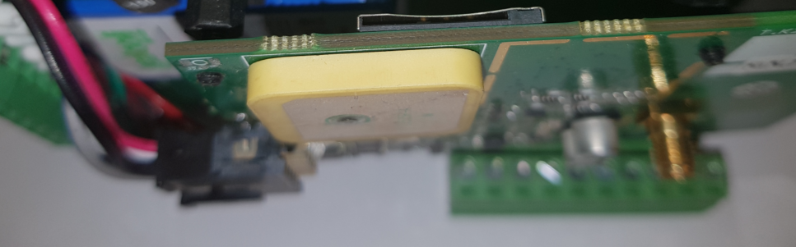
Sim Card
Location of Sim Card Slot
Insert card into device until you hear a click

